Slide 1
Seth & Ken’s Excellent Adventures (in Secure Code Review)
Global AppSec Amsterdam- 2019

Slide 2

Introductions - Ken
TLDR; Ginger; AKA the Spinal Archinator
Securer of Code...really, all of the code.
Known to the underground beaver pelt collecting community as the Spinal Archinator, for his activism in rebuilding beaver dams in the Yukon territories using only his teeth, in true beaver form.
@cktricky

Slide 3

Introductions - Seth
Once known as the “King of Cola”, he ruled the mighty Carbonators during the pre-century, west-coast Soda Wars. His rule was cut short when HFCS was outlawed by California and the sugar prohibition era began. He led the first manned mission to Mars via a hot air balloon. Without hot air. Or the balloon. He speaks 14 languages, 12 of them based on the science fiction show “Star Trek”, 1 he made up with his imaginary friend Sharzazzle, and really - really poor Ol’ Timey English.
@sethlaw

Slide 4


Slide 5

Overview
Repeat after me:
Reviewing code is excellent!
Finding vulnerabilities is excellent!

Slide 6
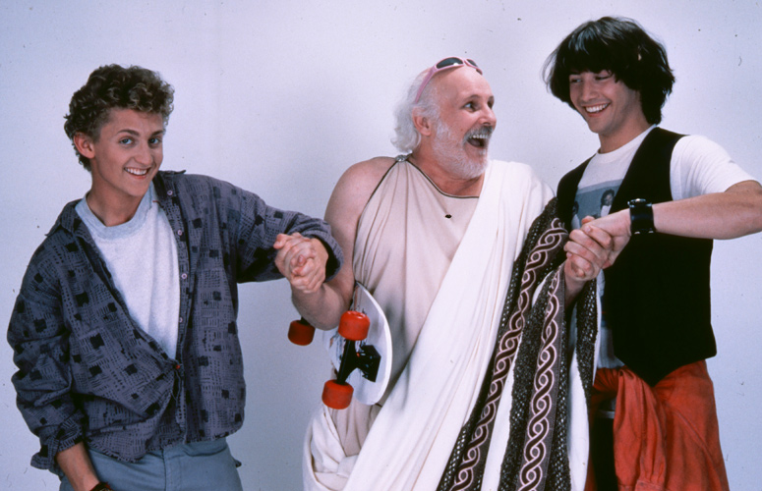
Philosophy - Part 1
Increase the likelihood of success. Not “find every bug imaginable”.
Successful is defined as:
Focusing on what matters by taking a risk based approach
Comprehensive
Timely
Easily consumed, well drafted reporting
Detailed notes
Notes:
There are certainly language and technology specific vulnerabilities and solutions - for example - nosql injection with Mongo or Metaprogramming issues in Rails, but there are principles that can be used in terms of language agnostic approaches. We want to cover the language / framework specific stuff but tie it back to an approach principle

Slide 7
Philosophy - Part 2
Language Agnostic Principles
Learn how to be an expert in becoming an expert
We’re here to learn a repeatable systematic approach to finding bugs
But with understanding that you may later choose to tweak this approach to suit you
Notes:
There are certainly language and technology specific vulnerabilities and solutions - for example - nosql injection with Mongo or Metaprogramming issues in Rails, but there are principles that can be used in terms of language agnostic approaches. We want to cover the language / framework specific stuff but tie it back to an approach principle

Slide 8
What to Expect
Our Experience and Stories
Specific Information about Code Reviews
Interactive Hands-On Exercises
Practice, practice, practice
Notes:
This course is designed to teach about the approach to conducting security code reviews, no the specifics of any one language. We will be talking about our experience conducting code reviews over the last 15 years, how we go about it, and practice the techniques we have found successful.

Slide 9

The Circle-K Framework
Open a file, take notes :-)
Get to know the application purpose
Map the application
Brainstorm risks to the application
Build your list of review items
Perform all reviews
Double back (3-6)
Notes:
The Circle-K framework is the generic activity list we follow each time we conduct a review. It’s important to hit 1-3 FIRST before digging into actual vulnerability discovery. Expect to spend at least as much time doing this as anything else. We will refer back to this framework again and again during this course.

Slide 10

Let’s talk about approach
Notes:
So let’s talk about how this happens in reality. How many people here conduct code reviews on a regular basis?
How is this work scoped out? What’s the cost (man hours/business)?

Slide 11
Let’s talk about approach
Several types of reviews:
You decide how much time you spend on the review (ideal world)
You have no time at all (real world)
Middle ground where you have a set time and scoped (hopefully) well or at least semi “okay”
NONE OF THESE TYPES MEAN “RUN A SCANNER AND ANALYZE THE RESULTS”
Notes:
https://smartbear.com/learn/code-review/best-practices-for-peer-code-review/ - 400 lines of code per hour

Slide 12
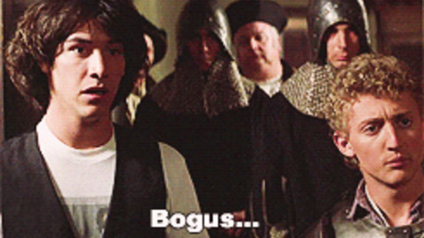
Let’s talk about approach

Slide 13
Now, what are we doing here?
This course is intended to do the following, at a high level:
Show you where to look - Source to Sink
Show you what to look for, examples:
AuthZ/AuthN
Vulns specific to the type of app
General/OWASP AppSec vulns
Show where automation fits in the source code review process
Show some validation and remediation of the issues

Slide 14
Also, what we aren’t doing
This course is not intended to:
Teach you the OWASP Top 10
Review web vulnerabilities
Cover techniques for finding vulnerabilities in running applications
Be a primer on building secure applications
Cover all the ways that vulnerabilities manifest in code.

Slide 15
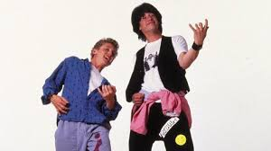
Tools/Lab Setup
Virtual Machine Setup/Installation (Virtualbox || VMWare)
Tool and environment familiarization

Slide 16
OWASP
How does the OWASP Top 10 relate?
What resources does OWASP provide?
How does this course differ from the OWASP Code Review Methodology?

Slide 17
Code Review Methodology
Overview

Slide 18
Introduction to the Methodology
Application Overview & Risk Assessment
Information Gathering
Authorization Review
Authentication Review
Auditing Review
Injection Review
Cryptographic Review
Configuration Review
Reporting

Slide 19
General Code Review Principles
Give yourself adequate time
Work in small chunks
Stay on task with current objective
Don’t make it personal
Ask questions
Framework/Code documentation is your friend
Build the code
Run the tests

Slide 20

Focus on what’s important
What happens when you run into 2 million lines of code?
And only have two weeks to look at it?
We will talk more about this...

Slide 21
Review Types

Slide 22

Review Types
Full assessment of an entire application
Assessment of new code developed since last review
Pull request or small code changes review
Scanner findings

Slide 23
Full assessment of an entire application
1. Full Assessment 💯
Everything is applicable
Depends 👀… seen this app before?
Context specific bits (authz functions, logic processing, db queries, etc.)
Meh
2. Only new code 👍
3. Pull Request Review 🔎
4. Scanner Findings 🤷‍♂️

Slide 24
Application Overview & Risk Assessment

Slide 25
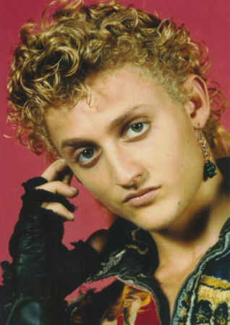
Application Overview & Risk Assessment
Build a portrait of the application
Behavior Profile
Technology Stack
App Archeology

Slide 26
Application Overview & Risk Assessment
Behavior Profiling:
What does it do? (business purpose)
Who does it do this for? (internal / external customer base)
What kind of information will it hold?
What are the different types of roles?
What aspects concern your client/customer/staff the most?
Notes:
Think of yourself as an FBI profiler but instead of serial killers… its apps and their developers

Slide 27
Application Overview & Risk Assessment
Technology Stack:
Framework & Language - Rails/Ruby, Django/Python, mux/Golang
3rd party components, Examples:
Billing libraries (rubygem, npm, jar, etc.)
JavaScript widgets - (marketing tracking, sales chat widget)
Reliant upon other applications - such as receiving webhook events
Datastore - Postgresql, MySQL, Memcache, Redis, Mongodb, etc.

Slide 28
Application Overview & Risk Assessment
App Archeology
Look at the documentation. Examples:
Using SSO? SAML/OAuth?
What third-party elements does communicate with? (eg: external reporting, billing)
Custom authentication schemas - for instance - different auth for API versus web interface
Git allows you to do a little spelunking
Unit Tests
Learn about the data endpoints expect to receive
Learn about expected behavior
Often can find the way to form/craft a request

Slide 29
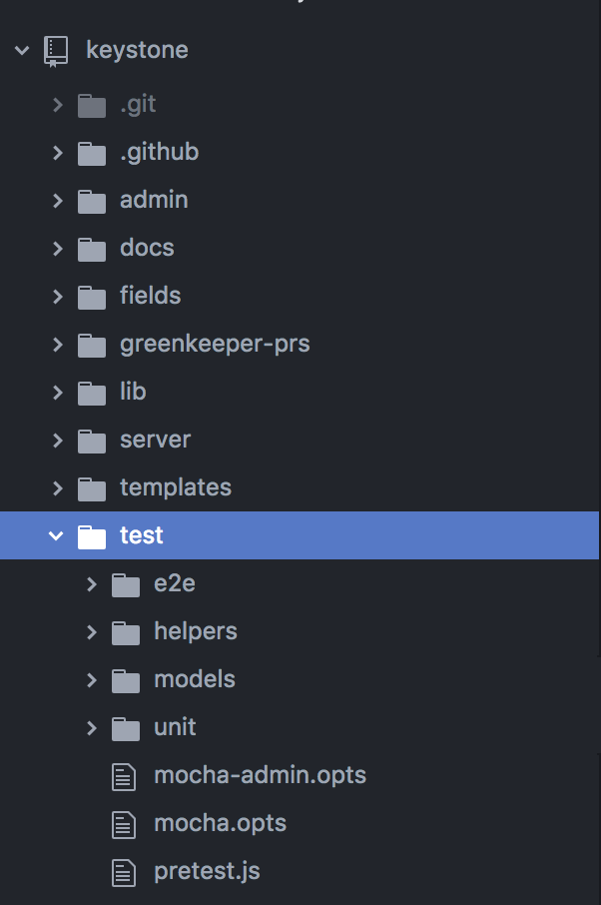
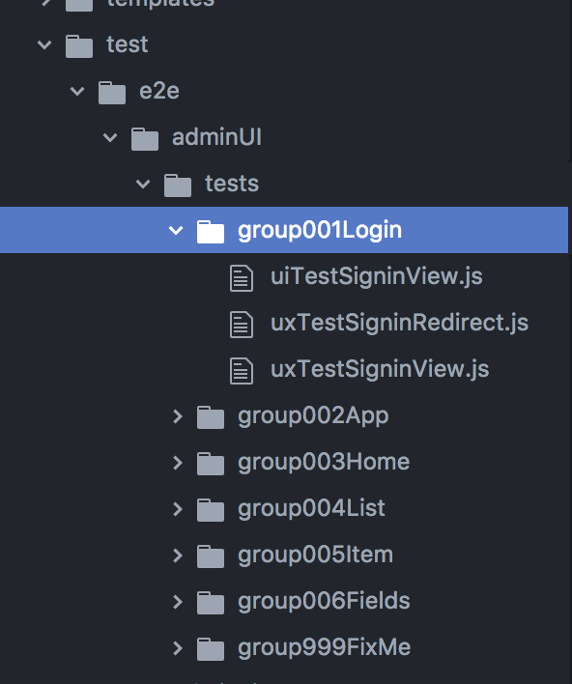
Application Overview & Risk Assessment
https://github.com/keystonejs/keystone

Slide 30
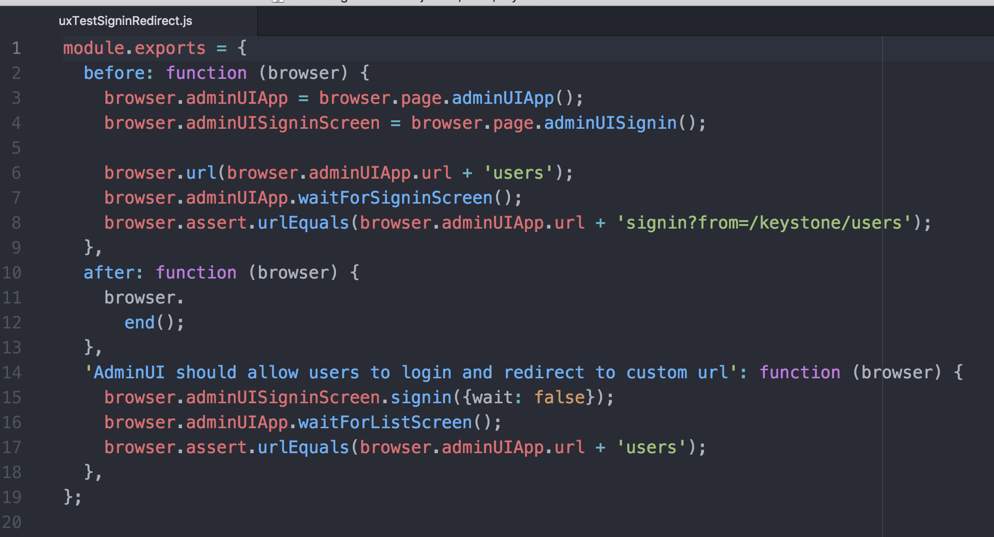
Application Overview & Risk Assessment

Slide 31
NOTE TAKING

Slide 32
NOTE TAKING
Format I typically use
Commit # if I have it
Two sections
Actual Findings
Notes from the review
Actual finding gets filled out at the end
Description / Recommendation
Optional (or not) - Impact/Risk
Includes links to the code in question and/or screenshots
If applicable, reproduction steps but that might not be possible if purely static
Avoid emotive words
Notes from the review include (at a minimum)
Route mapping
Brainstorming risks or “Threat model” details (really, rambling thoughts about what could go wrong”
PAIR WITH OTHERS!!!
Checklist of items you’ve checked for based on your threat model but also your normal “things” you should look at

Slide 33
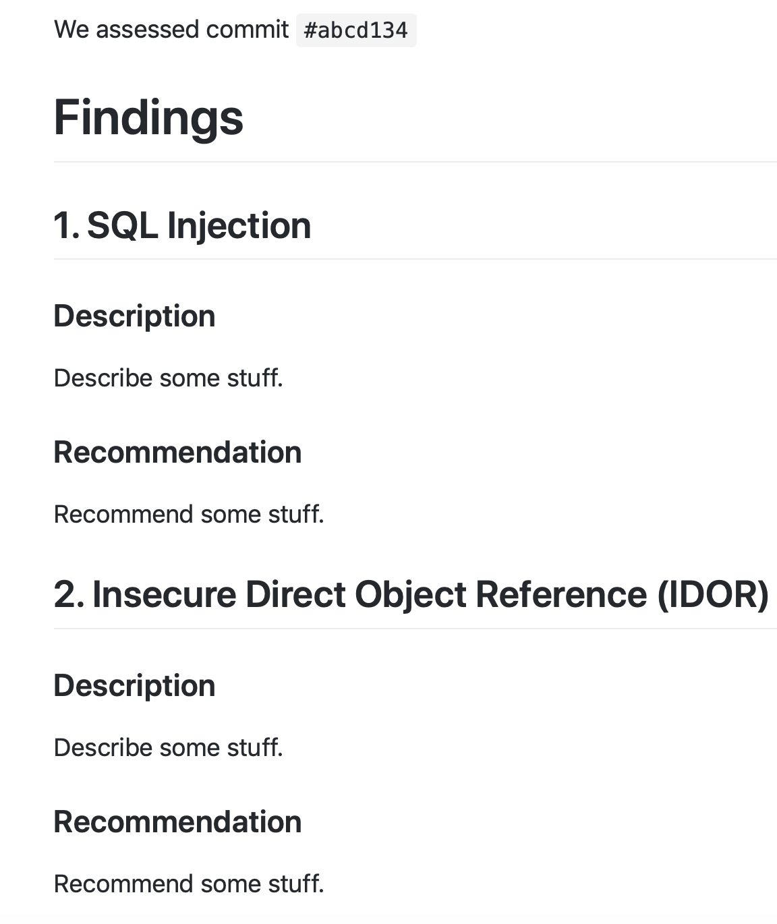
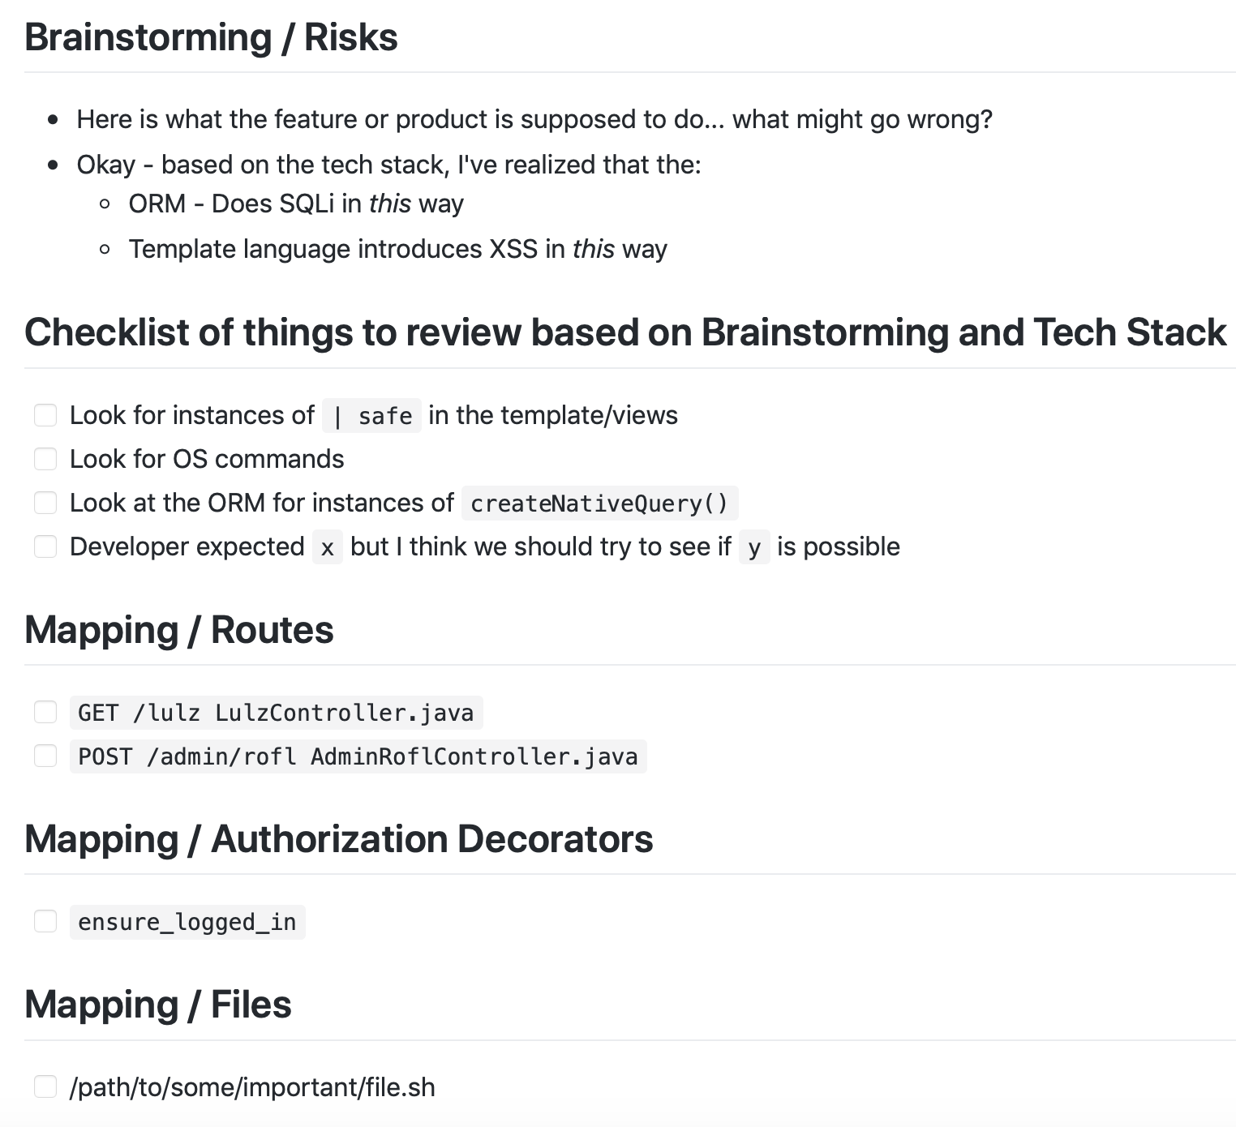
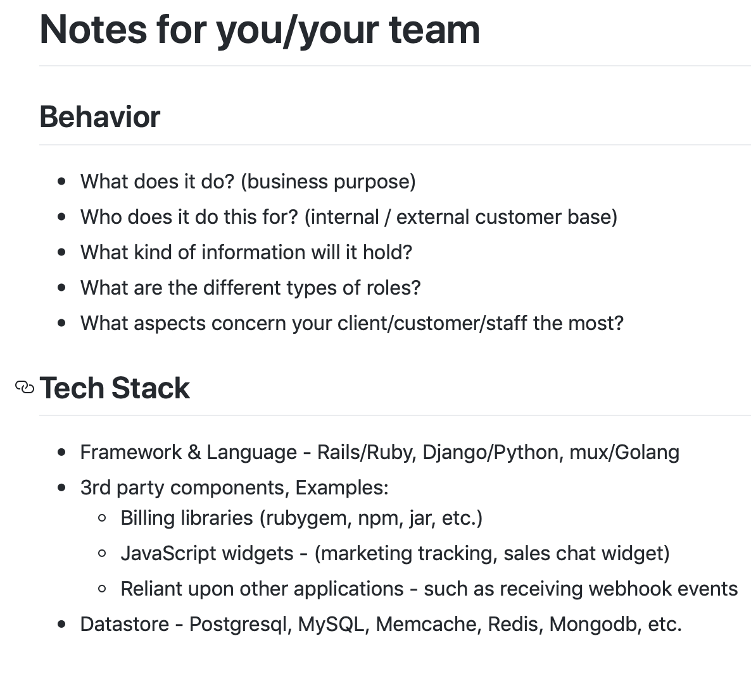
NOTE TAKING - SAMPLE
https://github.com/zactly/handouts/blob/master/example_template.md

Slide 34

Application Overview & Risk Assessment
Exercise Napoleon
Start secure code review of ~/code/keystone
Tech Stack
Business Purpose
Application Risk
Anything else?
Notes:
Review Keystone and Take Notes about its purpose

Slide 35
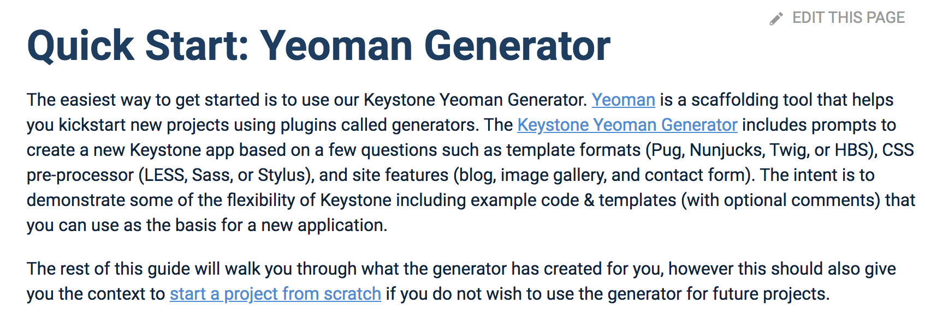
Napolean Exercise - Post-Mortem
At a minimum, these items were of note:
Tech Stack:
Node.js application
Using Express
Leveraging MongoDB, using Mongoose as the ORM
Business Purpose
Content Management Software
Documentation
https://keystonejs.com - Routes, Model schemas, Template lang can all be customized
Yeoman generator describes some of the tech options used

Slide 36

Napoleon Exercise - Post-Mortem
Other security important parts of the app:
Authentication and Session Management - lib/session.js
The security folder :-)
CSRF implementation
X-Frame-Options / frameguard
IP Blocking
Admin folder
You learn React is used
Logic for admin signins admin/server/api/session/signin.js

Slide 37
Information Gathering

Slide 38

Information Gathering
THE MOST IMPORTANT THING IS TO UNDERSTAND THE APP

Slide 39
Information Gathering
Create a map (Mapping)
Identify endpoints, typical examples:
Rails = config/routes.rb
Django= urls.py
Node.js = index.js (and a whole bunch of others)
Java Spring = *Controller.java (Search for *Mapping)
.Net Core = *Controller.cs (Search for Routeprefix and Route)
Endpoints typically have at least three qualities
Authorization Filter
Logic processing
Datastore access

Slide 40
Information Gathering
Review authorization filters/decorators
How do we identify the user? eg: Session, Token, Basic Auth
What is the purpose? Authenticated users, Role check, or something else?
Identify what could go wrong
User-supplied parameters (IDOR)
CSRF… bet you didn’t see that coming! :-)
Client-side cookies, JWTs etc. (just general wonkiness in persistence)
Story time… .NET & Response.Redirect("example.aspx", false);

Slide 41
Story:
Redirection & Authorization Issue in .NET

Slide 42
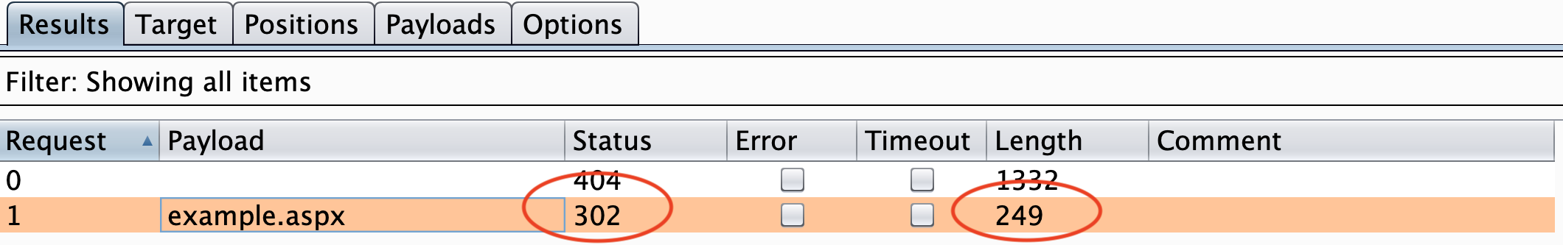
Redirection & Authorization Issue in .NET
Normal

Slide 43
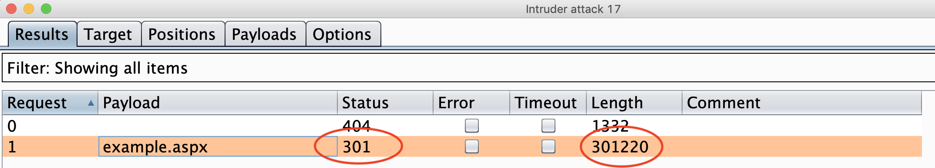
Redirection & Authorization Issue in .NET
Definitely NOT Normal

Slide 44
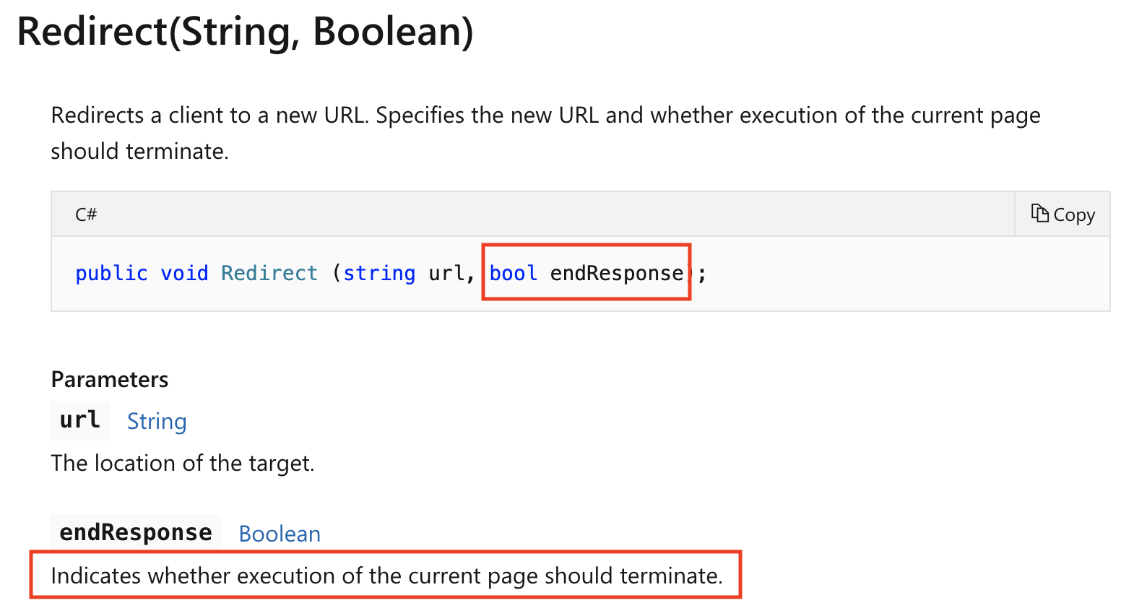
Redirection & Authorization Issue in .NET

Slide 45
Routing

Slide 46
Mapping

Slide 47
DB
Routing
Authorization
Processing Logic
External services
Typical Application Flow

Slide 48
Data Store
Processing Logic
app/models/*.rb
Authorization
Routing
config/routes.rb
before_action
before_filter
app/controllers/*.rb
External services
In Code
Rails Application Flow

Slide 49
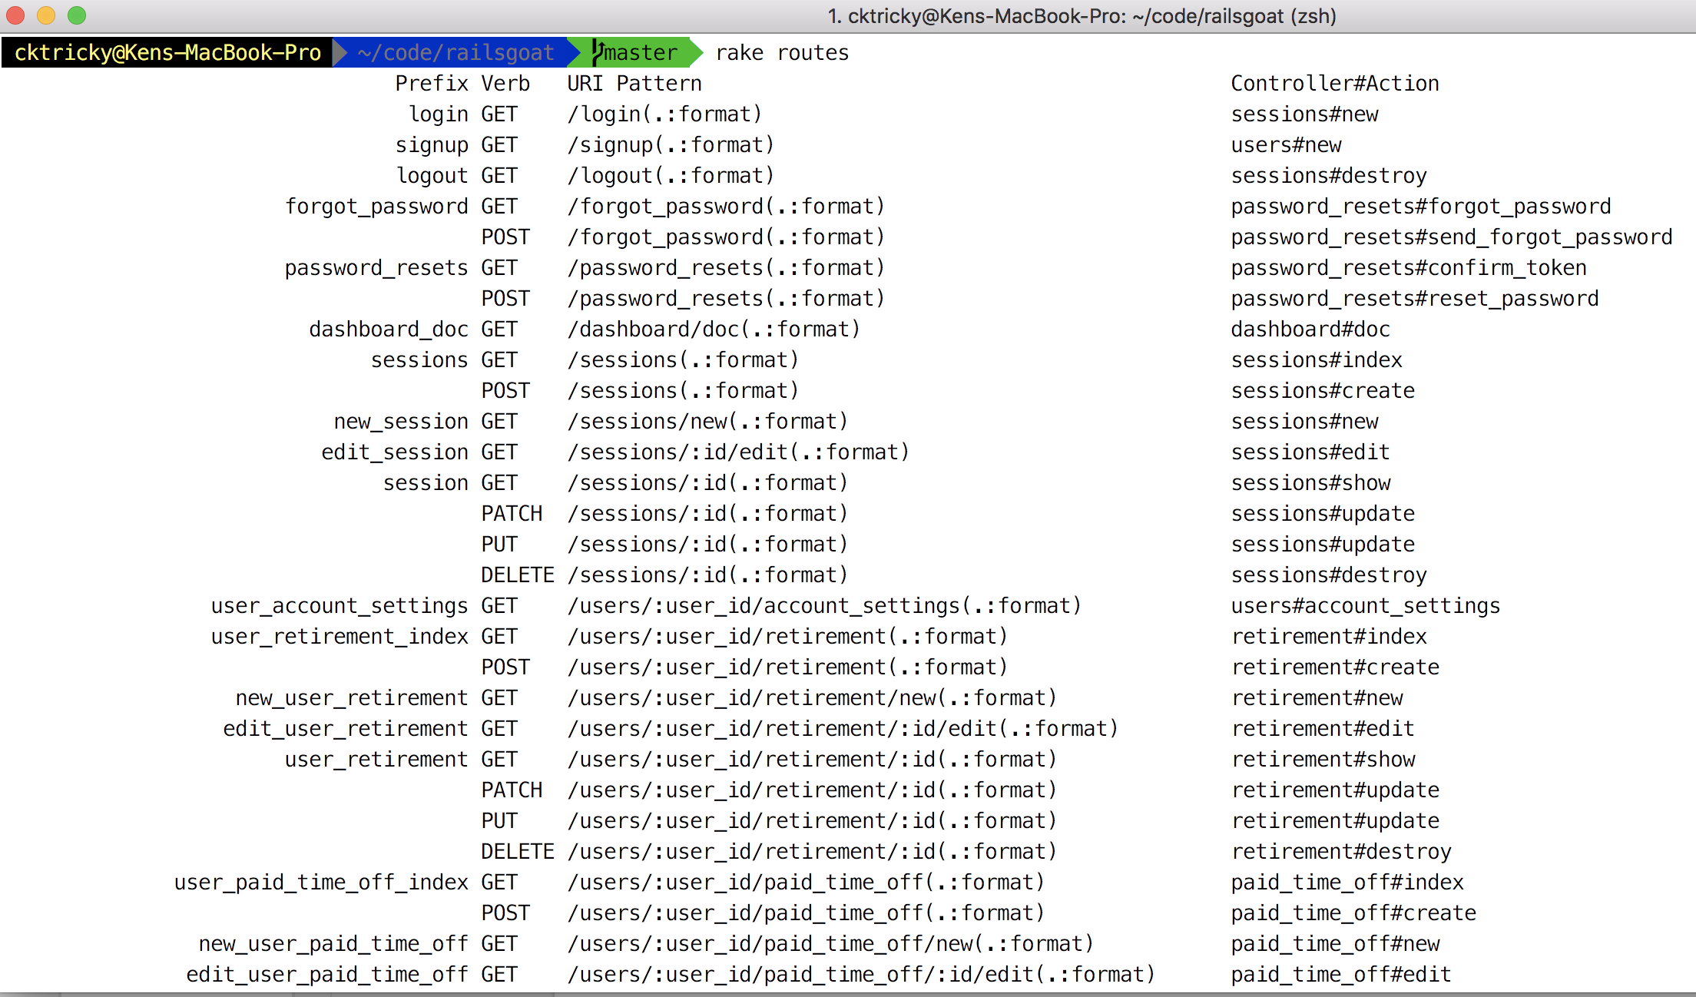
Rails - Map
Run “rake routes” if you can!

Slide 50
Rails - Map
Four parts
Path name (eg: forgot_password_path)
HTTP Verb (eg: GET)
HTTP Path (eg(s): forgot_password, forgot_password.json, forgot_password.xml)
Controller and Action (eg: Controller = password_resets, Action = forgot_password)

Slide 51
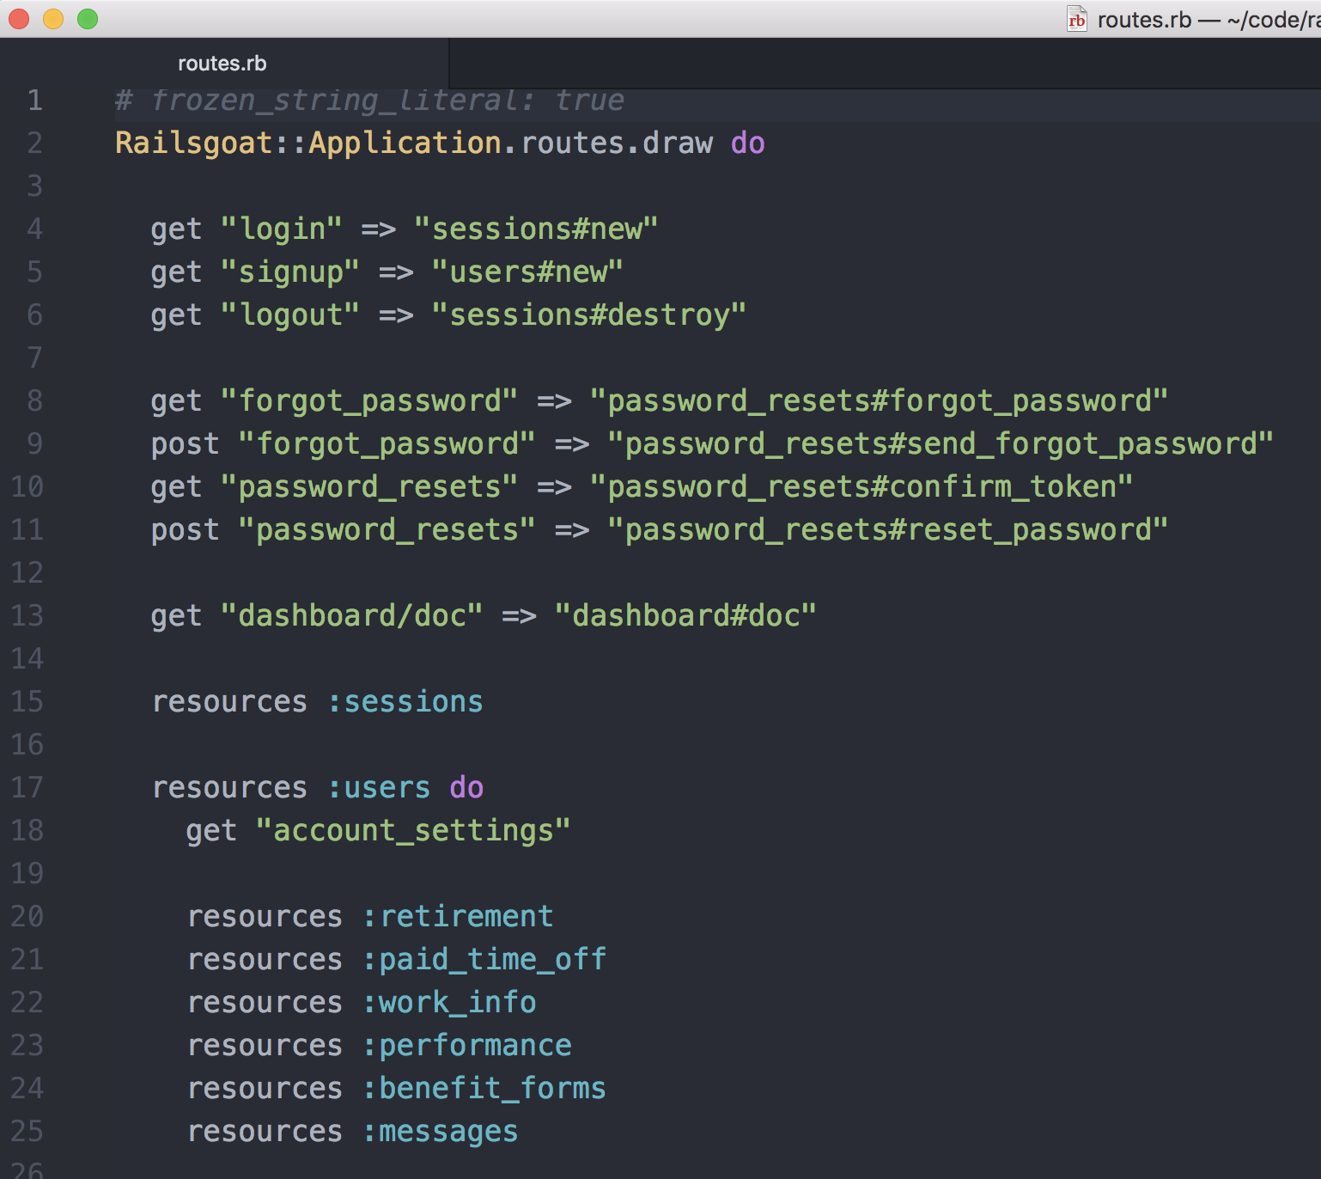
Rails - Map
If you cannot run rake routes, you’ll have to review the config/routes.rb file:

Slide 52
Rails - Routing Weirdness Alert
What do PUT, PATCH, DELETE, and POST all have in common?
That’s right, they are all POST requests
Rails uses the _method parameter to determine what kind of request it is

Slide 53
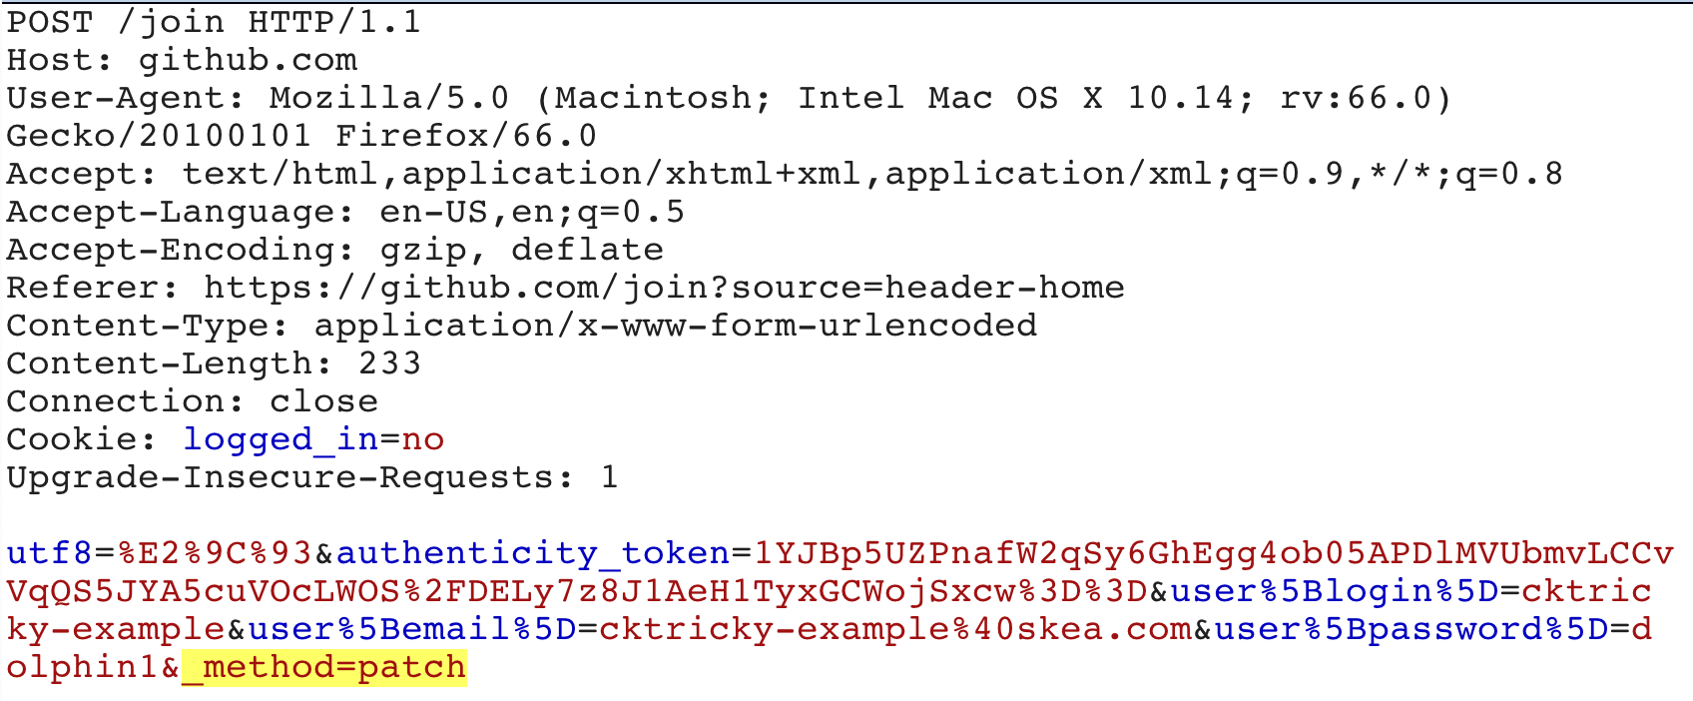
Rails - Routing Weirdness Alert

Slide 54
Data Store
Processing Logic
Typically in processing logic.
Authorization
Routing
Last call in route definition
app.post(“/”,index);
index.js (could be other places)
app.post()
app.get()
External services
In Code
Node.js/Express Application Flow

Slide 55
Node.js/Express - Map
My formula has been super basic, searching for:
app.get
app.post
app.delete
I always like to also annotate which of these is actually using middleware
We’ll create a checklist from this for tracing

Slide 56
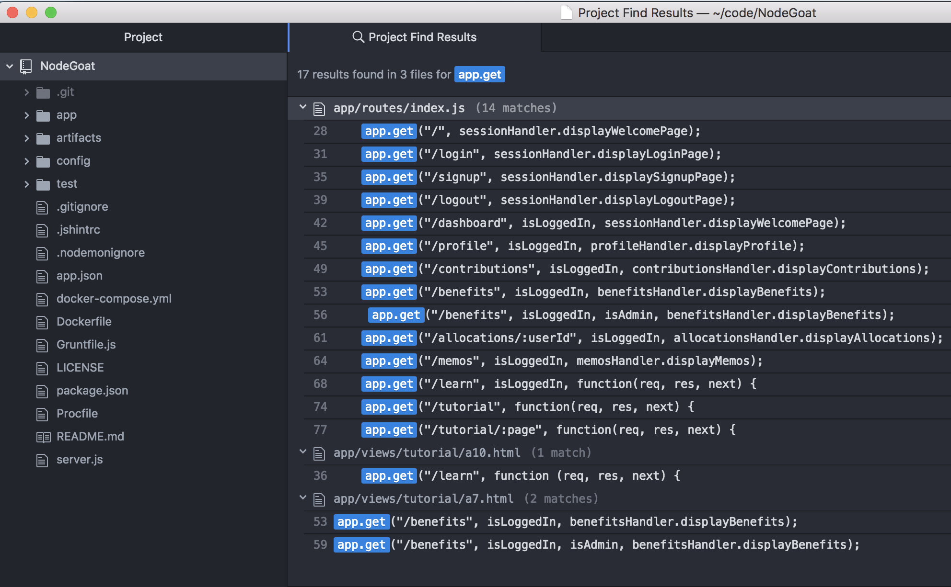
Node.js/Express - Map
Here is an example from Nodegoat, I downloaded it, and searched for app.get

Slide 57
Node.js/Express - Map
Take a close looksie

Slide 58
Data Store
Processing Logic
Authorization
models.py
Routing
urls.py
@login_required
(decorators)
views.py
External services
In Code
Django Application Flow

Slide 59
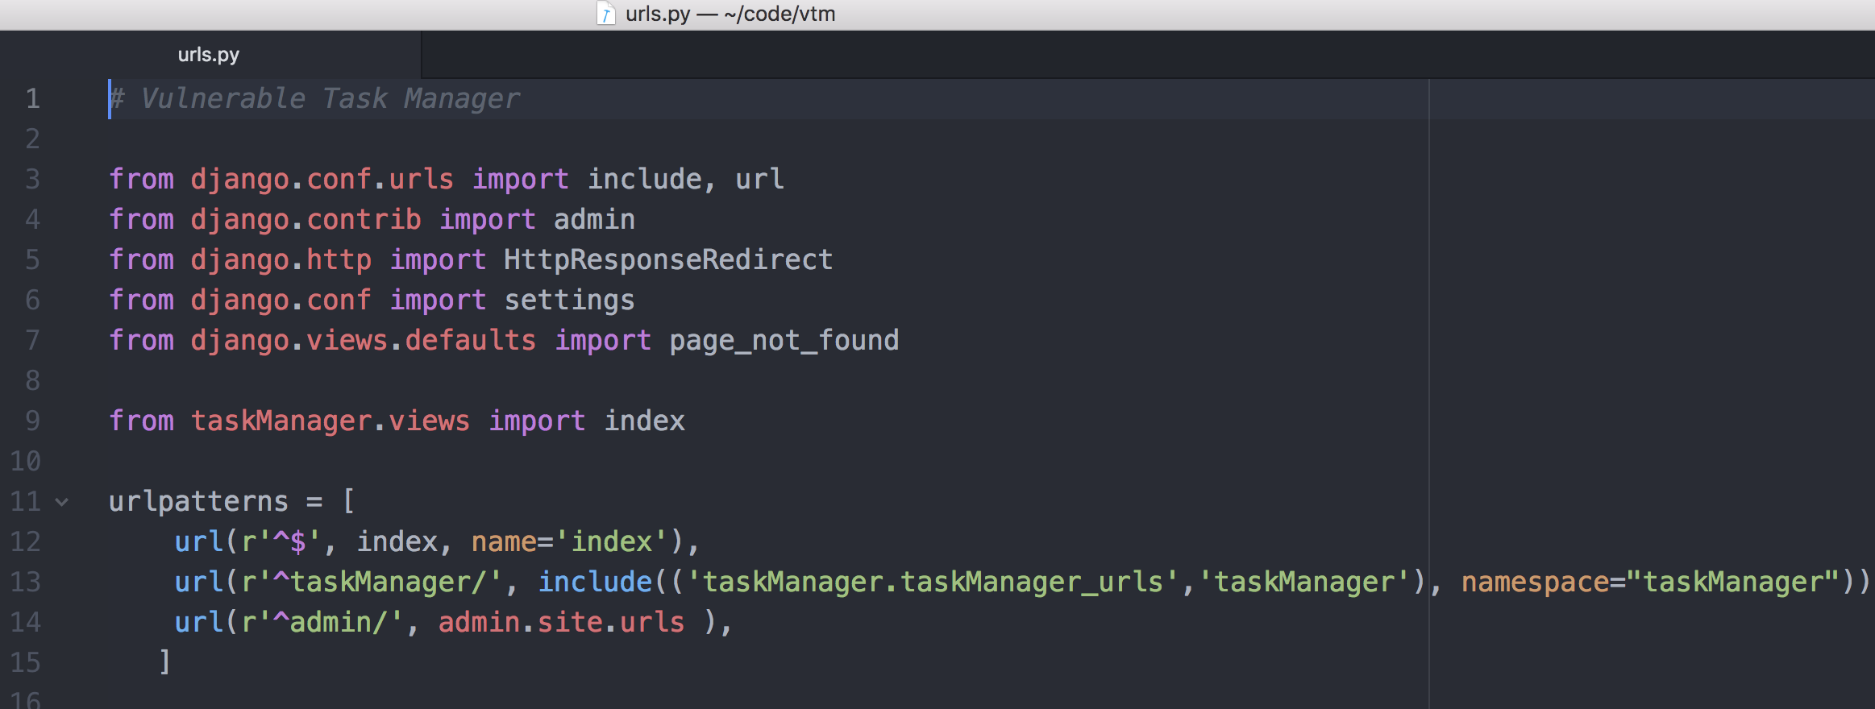
Django - Map

Slide 60
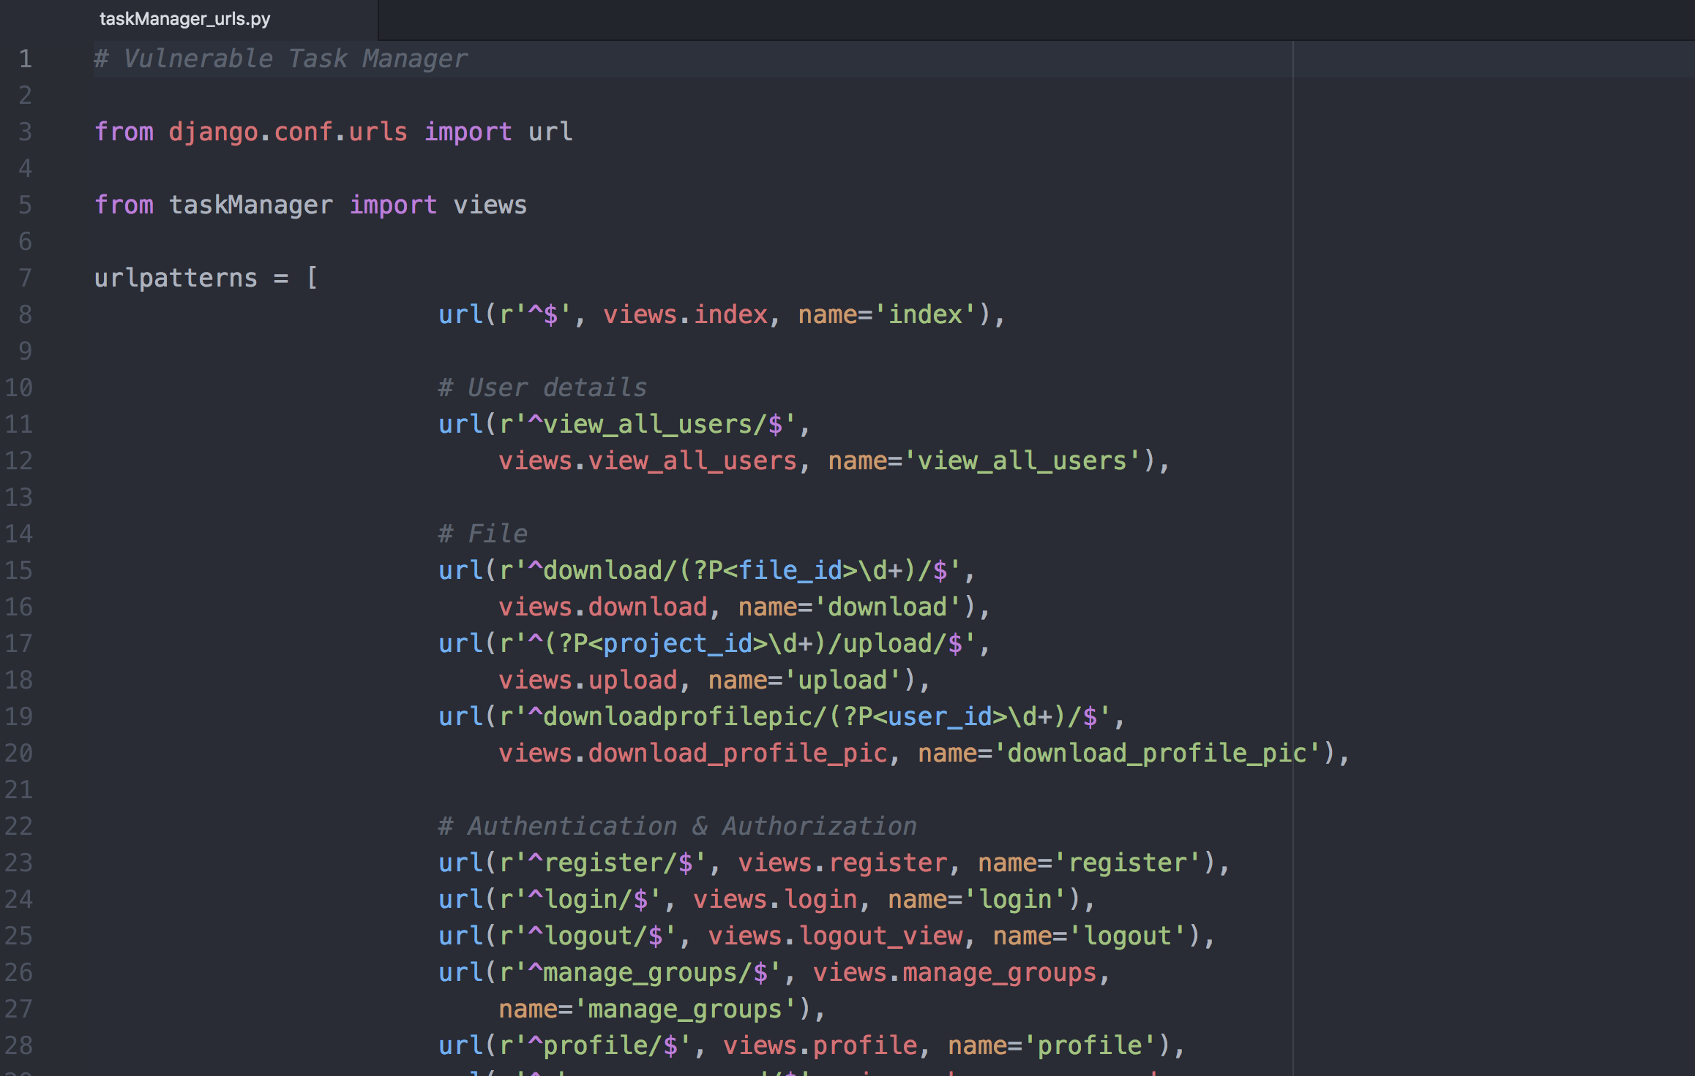
Django - Map

Slide 61
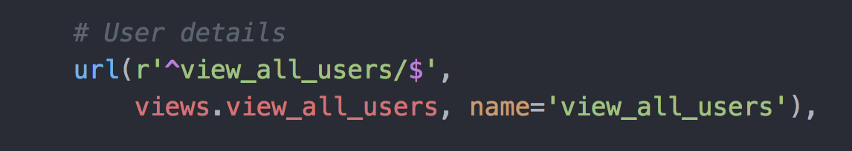
Django - Map

Slide 62
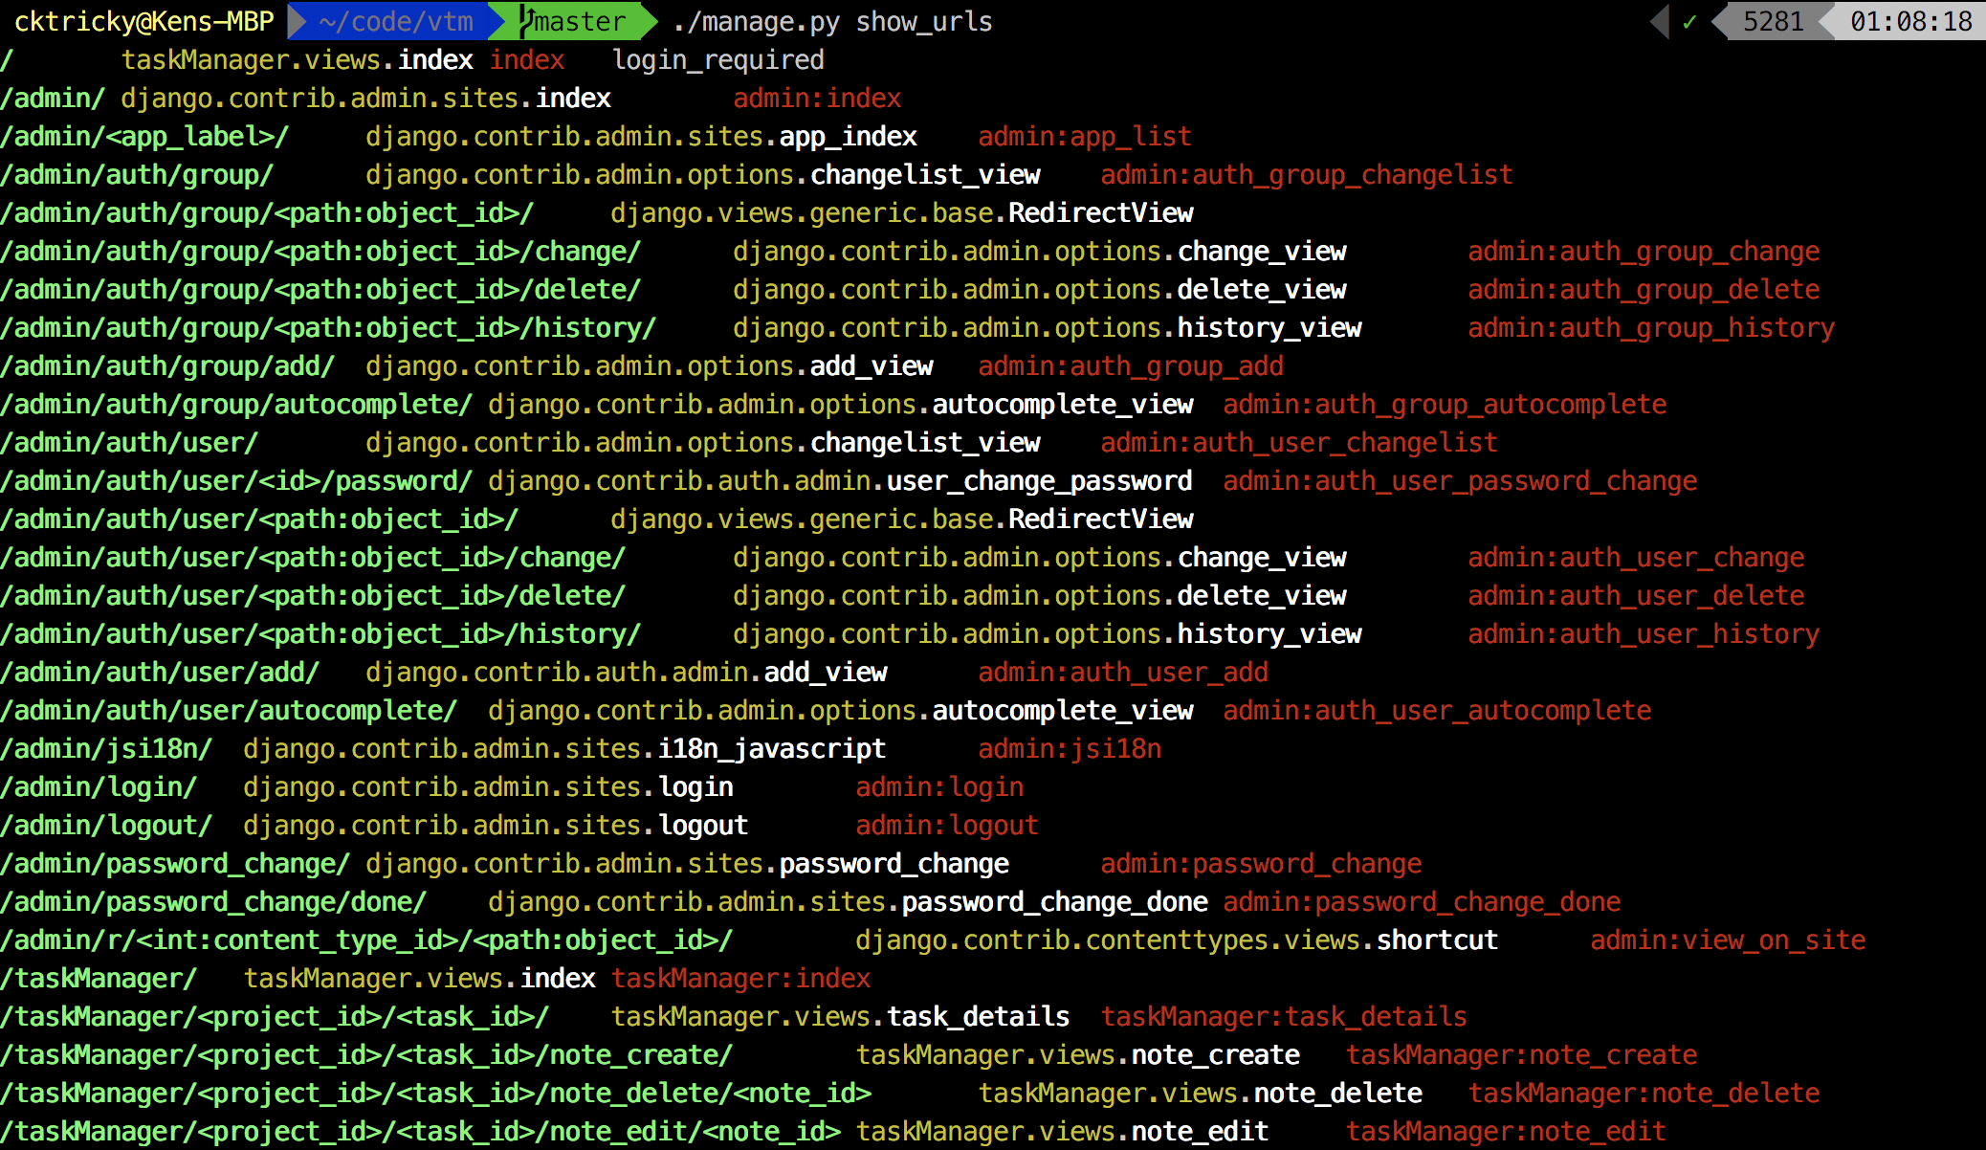
Django - Map

Slide 63
Data Store
Processing Logic
Authorization
Models/*.cs
Routing
@authorized
(decorators)
<Name>Controller.cs
In the function, after the Route attribute
External services
In Code
.Net Application Flow

Slide 64
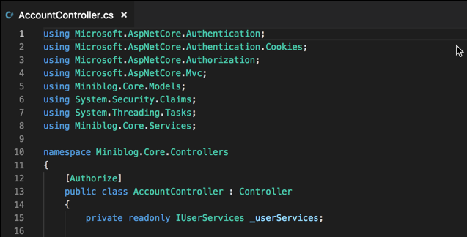
.NET Core - Map

Slide 65
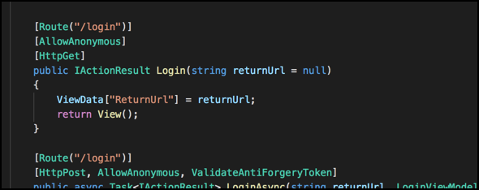
.NET Core - Map

Slide 66
Data Store
Processing Logic
Authorization
Models/*.java
Routing
Authorize
(decorator)
<Name>Controller.java
In the function, after the Route attribute
External services
In Code
Java Application Flow

Slide 67

Mapping
Exercise Rufus
Start secure code review of ~/code/skea_node
Perform Info Gathering
(Tech Stack/Biz Purpose/Risk Assessment)
Map Routes
Continue secure code review of ~/code/keynote
Map Routes

Slide 68
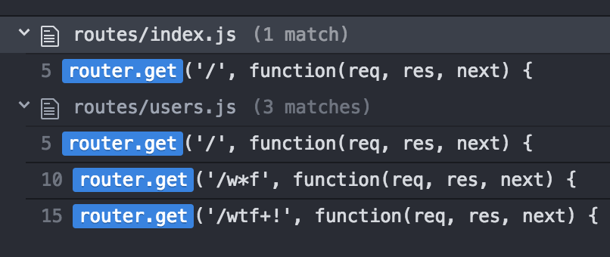
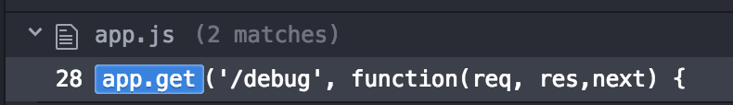
Rufus Exercise - Post-Mortem
Your notes should have
A commit #
Architecture/Frameworks
The end points shown to the right
Any interesting things you may have found such as
The fact the auth function doesn’t do anything
The fact we have a Debug statement in our app and its printing env variables
Notes:
Git commit needs to be fixed

Slide 69
Authorization Decorators

Slide 70
Authz Functions
We’ve got a whole section dedicated to authorization
This is about getting to know the application a bit better
If we find a flaw, even better, but we just need to do this to understand things
Is there an exception to the rule? Sure.
incorrectly/missing filters
Incorrectly configured, for example...

Slide 71
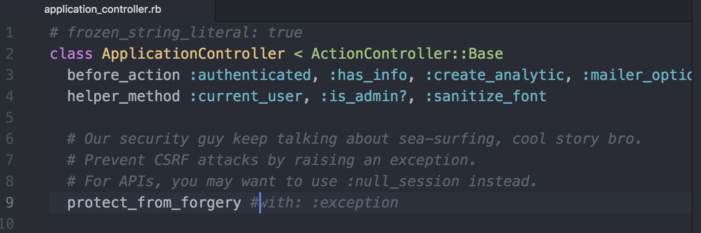
Authz Functions - Incorrectly Configured Example

Slide 72
Authz functions checklist
How are users identified
Session
Token
Basic Authentication
Something else?

Slide 73
Authz functions checklist
Identify its purpose
Is it just checking that we’re authenticated? - AuthN
Is it looking for a specific role? - RBAC
Is it doing some sort of HMAC verification for events?

Slide 74
Authz functions checklist
What could go wrong?
Insecure timing comparisons
Framework nuances
IDOR
Lack of rate limiting (see this often with basic auth or tokens)
Think about if it was *not* applied, what would happen
Get creative, you’re trying to decide what the risk, if any, is here

Slide 75

Authz Functions
Exercise Sigmund Freud
Start secure code review of ~/code/skea_rails
Perform Info Gathering
(Tech Stack/Biz Purpose/Risk Assessment)
Map Routes
Map AuthZ Functions
How are users authorized in ~/code/skea_rails?
Could take some time

Slide 76
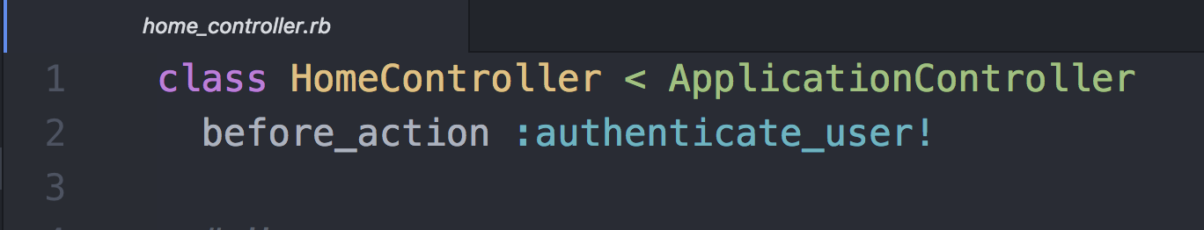
Sigmund Freud Exercise - Post-Mortem
Yeah, you probably have questions re: “authenticate_user!”
Which is why its part of the exercise :=D. THIS HAPPENS A LOT!
How to decipher where this action is defined will be defined by:
Access to an interactive runtime env?
Experience with the framework/libs?
No previous experience with it, only access to source?

Slide 77
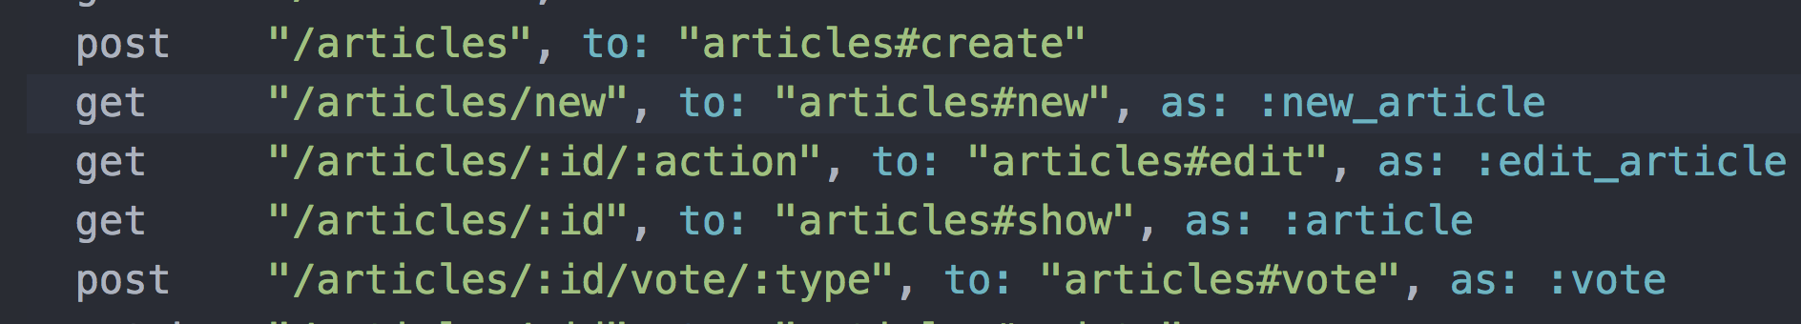
Sigmund Freud Exercise - Post-Mortem
Did you catch the CSRF? - “Framework Nuance”

Slide 78
Sigmund Freud Exercise - Post-Mortem
Anyone know what the request attack string would look like?

Slide 79

Sigmund Freud Exercise - Post-Mortem
So what’s the point with this whole thing?
You need to do your homework on framework nuances
Good example of why I often double-back and check one last time… (story time)

Slide 80
Authorization

Slide 81
Authorization Review
Analyze source for role enforcement, appropriate user boundaries, privileges required for access, and business-logic flaws
Roles and associated enforcement routines must be identified during information gathering
Pay attention to any endpoints that include sensitive data or functionality
Vertical authorization weaknesses - escalated privileges
Authenticated and unauthenticated access
Horizontal authorization weaknesses - access another user’s data

Slide 82
Authorization Review Vulnerabilities
Broken Access Control - OWASP Top 10 A5:2017
Privilege Escalation
Missing Function Level Access Control
Insecure Direct Object Reference
Sensitive Data Exposure - OWASP Top 10 A3:2017
Mass Assignment
Business Logic Flaws

Slide 83
Authorization Review Checklist
What are the different authorization functions?
Token/User/Role validation?
Is this handled by custom framework functionality?
Decorators vs. static source code
Can non-privileged users view, add, or alter accounts?
Is there functionality to add accounts with higher access levels than their own access?
How is separation of duties handled?
Are disabled accounts prevented from accessing content?
Can password-protected pages be directly accessed without authentication?

Slide 84
Mass-Assignment
Goes by a few names
Insecure Binder Vulnerability
Insecure Object Mapping
Mass-Assignment
Typically happens when a database entry is created or modified and we do so by throwing in *all* user-supplied parameters
For example...

Slide 85
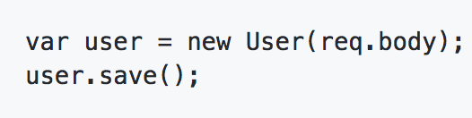
Mass-Assignment - Node

Slide 86
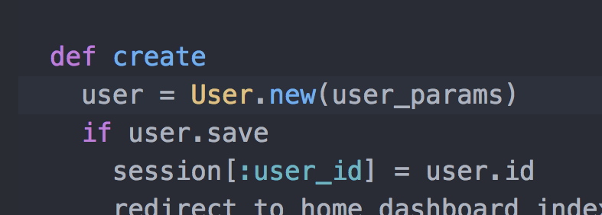
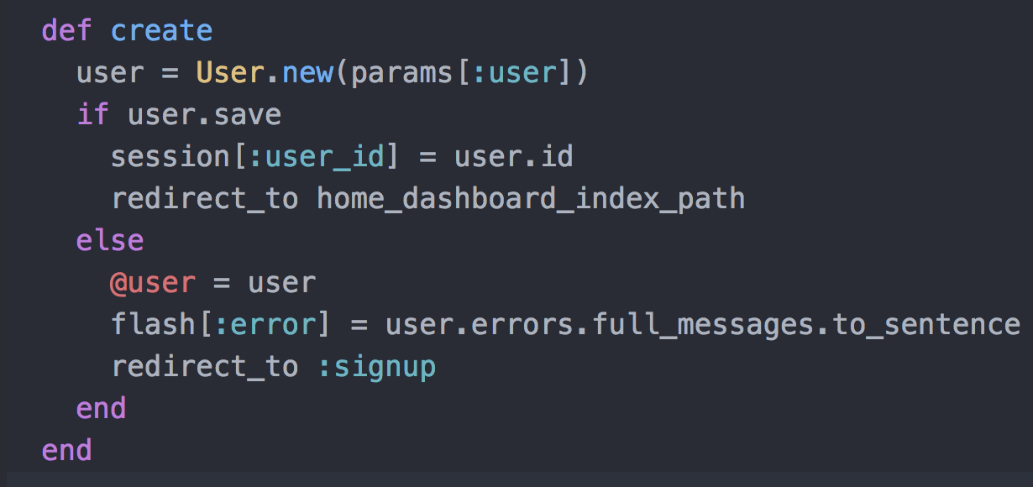
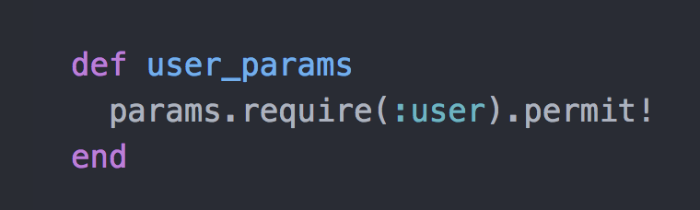
Mass-Assignment - Rails Rails 4+
Rails 2/3

Slide 87
Authorization Review Checklist
Is it possible to bypass authorization restrictions by accessing content directly (e.g. can a non-privileged user access the administration pages of an application)?
Can a user escalate privileges through cookie modification, altering form input values and HTTP headers, or by fuzzing URL-based parameters?
Are there horizontal escalation/Insecure Direct Object References in the source code?
Are authentication and authorization flows the first logic executed for each request?
Are authorization checks granular (page and directory level) or per-application?

Slide 88
Authorization Review Checklist
Are access to sensitive pages and data denied by default?
Are users forced to re-assert their credentials for requests that have critical side-effect (account changes, password reset, etc)?
Do authorization checks have clearly defined roles?
Can authorization be circumvented by parameter or cookie/token manipulation?
Are CSRF protections in place and appropriate?

Slide 89

Authorization
Exercise Genghis Khan
Start secure code review of ~/code/skea_django
Info Gathering
(Tech Stack/Biz Purpose/Risk Assessment)
Map Routes
AuthZ Functions
Build an authorization checklist
Test checklist items

Slide 90
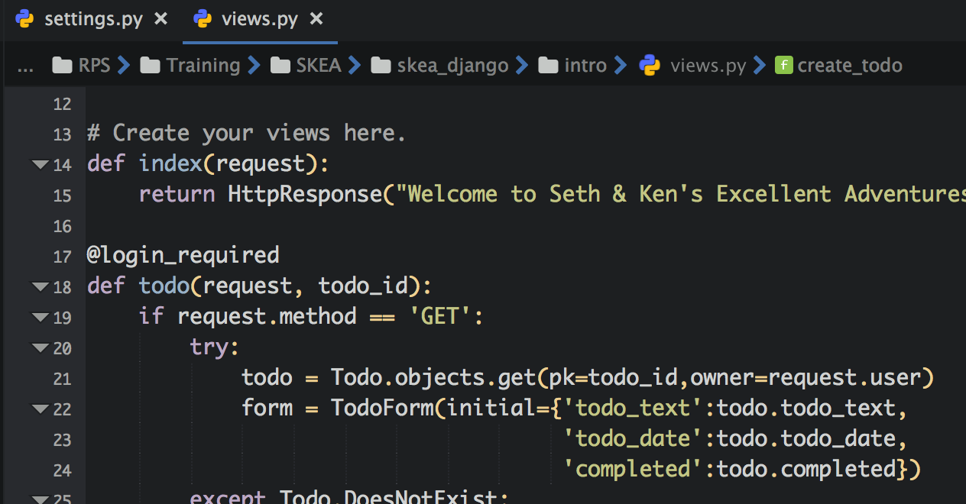
Genghis Khan Exercise - Post-Mortem
First of all look into views.py

Slide 91
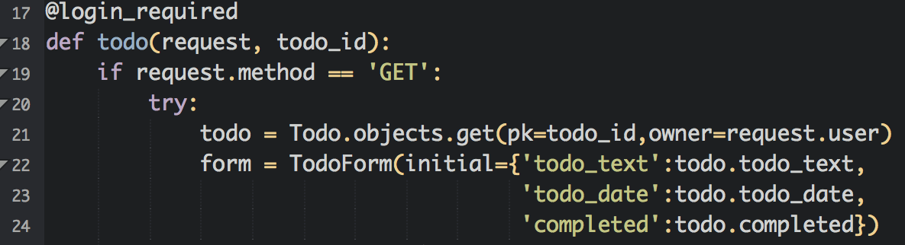
Genghis Khan Exercise - Post-Mortem
What about objects? Does it protect against IDOR? How?

Slide 92
Authentication

Slide 93
Authentication Review
Authentication establishes user identity
Examine the user identification process of the application.
Available application resources include both unidentified and identified users
Use enumeration of the application endpoints to trace the authentication flow and functions.
Sensitive application and business functionality should redirect as appropriate to the authentication flow to properly identify a user
Include an application functionality that identifies a user in this review

Slide 94
Authentication Review
How does an application confirm identity?

Slide 95
Authentication Review Vulnerabilities
Broken Authentication - OWASP Top 10 A2:2017
User Enumeration
Session Management Issues
Authentication Bypass
Brute-Force Attacks

Slide 96
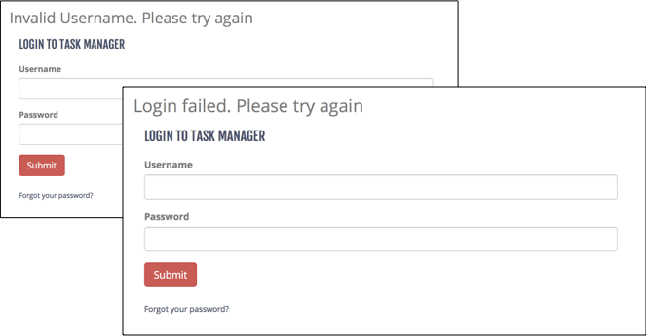
User Enumeration - Login Page

Slide 97
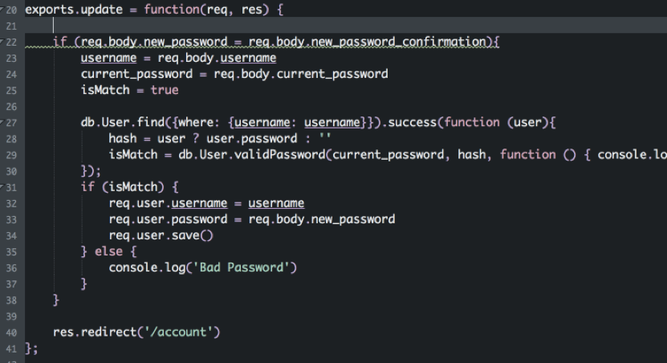
Broken Authentication - Node

Slide 98
Authentication Review Checklist
What are the different authentication flows?
User Login
User Registration
Forgot Password
How are users identified? What information do they have to provide?
Username, email, password, 2fa token, etc.
How is authentication handled on each application endpoint?
Sensitive endpoints should require authentication
Are there any hard-coded accounts?
Does application allow for easily-guessed, default, or common passwords?

Slide 99
Authentication Review Checklist
How are usernames determined, what naming conventions?
Does registration allow for easy enumeration?
Does the application allow for account enumeration through server responses or information disclosure?
login/registration/forgot password flows
Are user credentials protected in the data store using modern password hashing algorithms?
Are security policies are configurable via environment variables and not hard-coded?
What standard security frameworks are used?
Is there code specific to the application, especially when dealing with password storage?

Slide 100
Authentication Review Checklist
How are user management events such as authentication failures, password resets, password changes, account lockout and disabled accounts handled?
Are suspicious event handling such as multiple failed login attempts, session replay and attempted access to restricted resources handled properly?
Does the application implement strong password policies?
Are authentication credentials being passed using technologies that could be cached (HTTP GET, lack of proper cache-control settings)?
If applicable, are encryption mechanisms in place during authentication for secure communications (TLS, etc)?

Slide 101
Authentication Review Checklist (Sessions)
Are encryption and hashing used properly?
Do encryption protocols use strong algorithms and industry-standard key lengths?
Are authentication tokens set with time limits?
Are cookies security parameters set properly (e.g. Secure, HTTPOnly, path)?
Are session IDs sent over a secure channel?
Are session IDs invalidated before a new login is made?
Are CSRF tokens set for all authentication requests?

Slide 102
Authentication Review Checklist (Registration)
Are limits on application access, such as geographical boundaries, enforced properly?
Is there a manual approval process or is access granted automatically?
Can the automated process be abused or bypassed using scripting or brute-forcing?
In cases where a validation email and link are required, how are the tokens generated?
Can users elevate their initial access via mass assignment or business-logic bypasses?
Are files and objects owned by a user removed or archived?

Slide 103
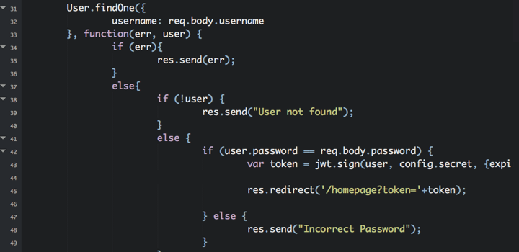
User Enumeration - Node

Slide 104
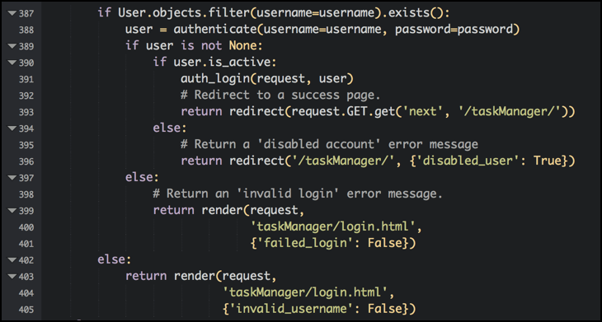
User Enumeration - Django

Slide 105
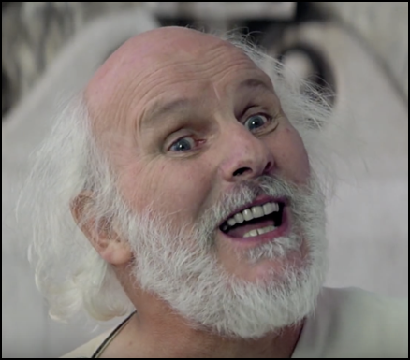
Authentication
Exercise Socrates
Continue review of ~/code/skea_django
Build/Review AuthN Checklist
Continue review of ~/code/keystone
Build/Review AuthN Checklist

Slide 106
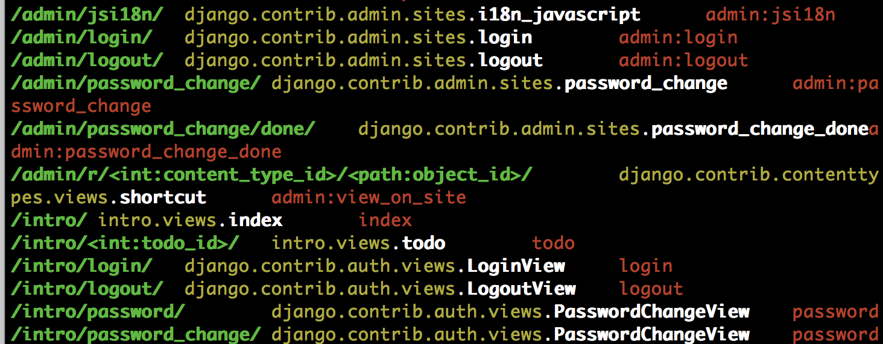
So-crates Exercise - Post-Mortem
So what exactly are we looking for?
./manage.py show_urls (django extensions have to be enabled).

Slide 107
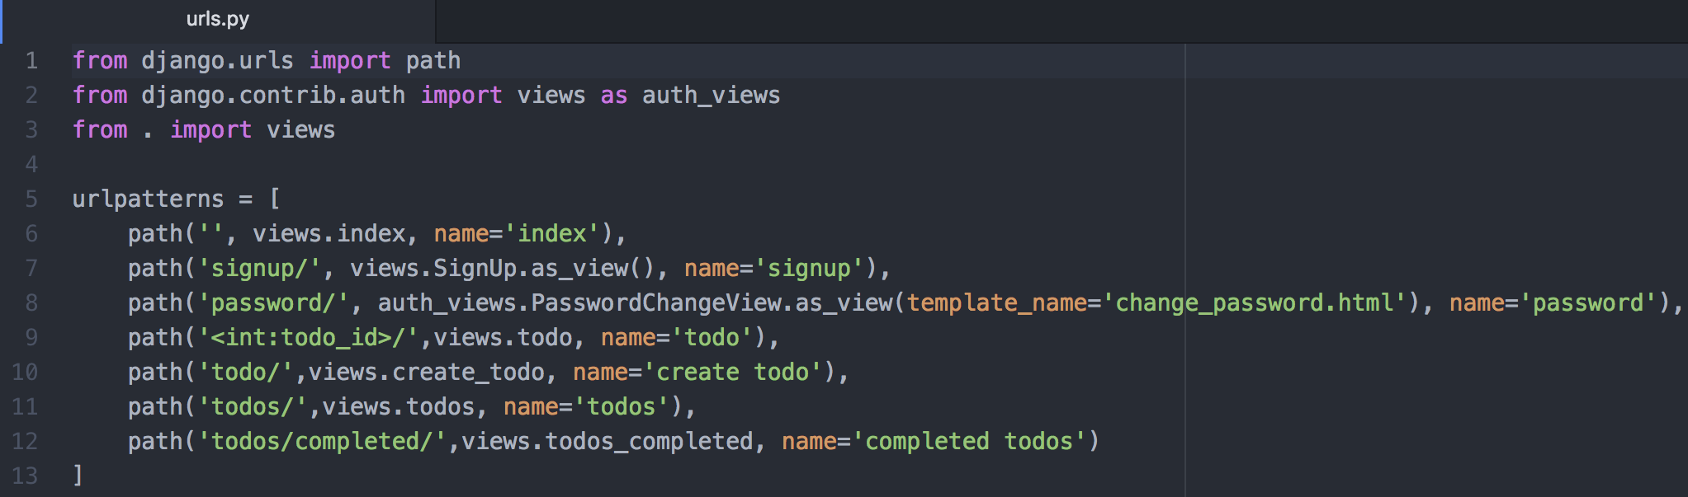
So-crates Exercise - Post-Mortem
Where do they go?
intro/urls.py has no references to login????

Slide 108
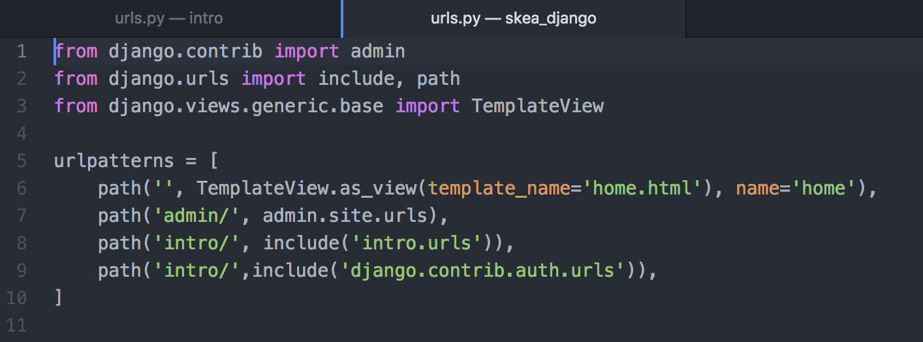
So-crates Exercise - Post-Mortem
Either does skea_django/urls.py - but there is a reference to django.contrib.auth.urls

Slide 109
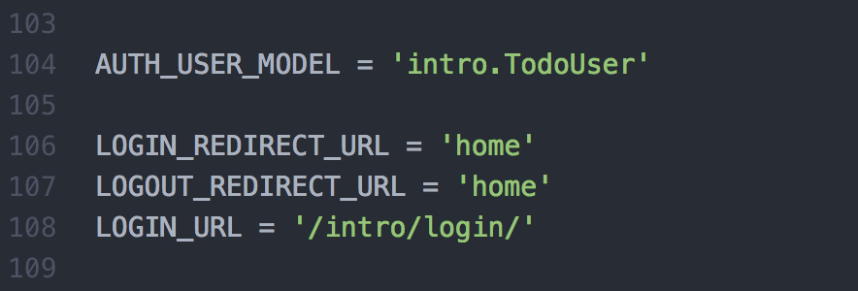
So-crates Exercise - Post-Mortem
Configuration documentation for django.contrib.auth leads us to skea_django/settings.py

Slide 110
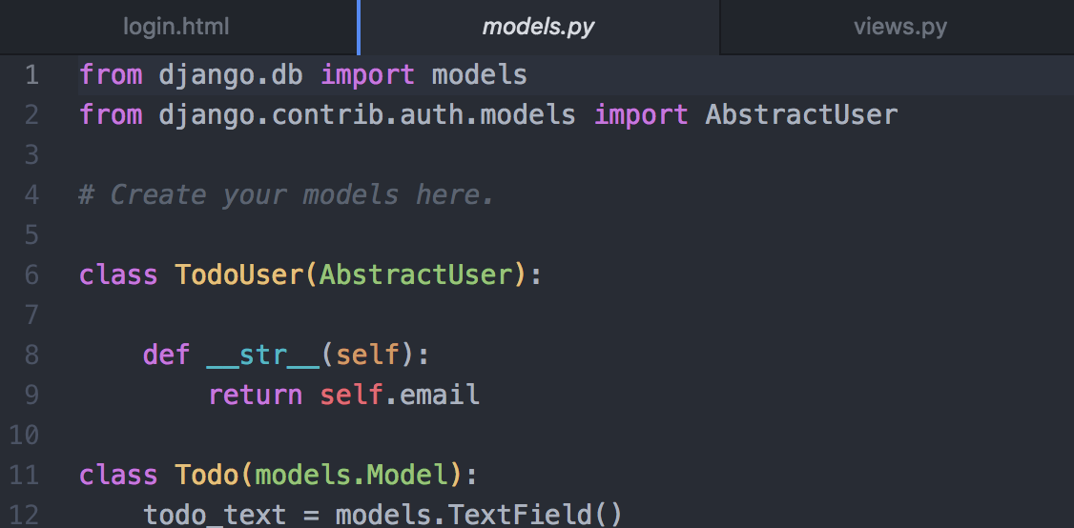
So-crates Exercise - Post-Mortem
Searching for django.contrib.auth leads us to intro/models.py

Slide 111
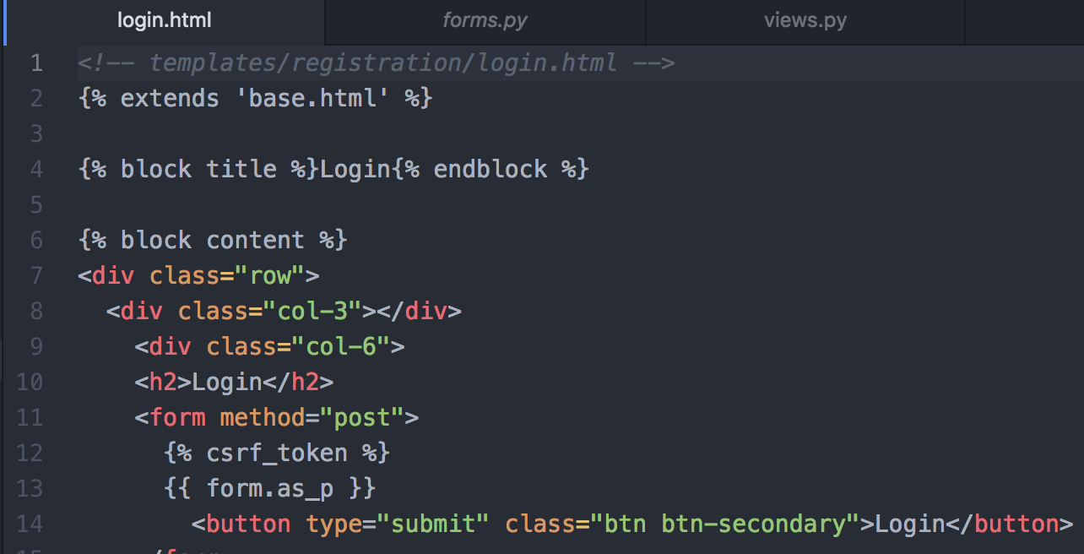
So-crates Exercise - Post-Mortem
If we go back to the django.contrib.auth documentation, it uses the templates in the registration directory.

Slide 112
Auditing

Slide 113
Auditing Review
Validate that appropriate logging and exception handling are handled within application source
One path in the trace of sensitive data from source to sink
Logging functions and error messages are considered a data sink
Logging should happen in any endpoint that performs a state-changing operation or has security implications
This data is used for immediate analysis and future forensics needs.
Check that sensitive data is appropriately handled (no credit card numbers, etc) and the correct details are logged
Administrators must trust that logs may not be manipulated by unauthorized parties

Slide 114
Auditing Review Vulnerabilities
Sensitive Data Exposure - OWASP Top 10 A3:2017
Insufficient Logging & Monitoring - OWASP Top 10 A10:2017
Debug Messages
Error Handling
Information Leakage

Slide 115
Auditing Review Checklist
If an exception occurs, does the application fails securely?
Do error messages reveal sensitive application or unnecessary execution details?
Are Component, framework, and system errors displayed to end user?
Does exception handling that occurs during security sensitive processes release resources safely and roll back any transactions?
Are relevant user details and system actions logged?
Is sensitive user input flagged, identified, protected, and not written to the logs?
Credit Card #s, Social Security Numbers, Passwords, PII, keys

Slide 116
Auditing Review Checklist
Are unexpected errors and inputs logged?
Multiple login attempts, invalid logins, unauthorized access attempts
Are log details should be specific enough to reconstruct events for audit purposes?
Are logging configuration settings configurable through settings or environment variables and not hard-coded into the source?
Is User-controlled data validated and/or sanitized before logging to prevent log injection?

Slide 117
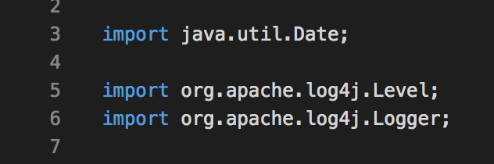
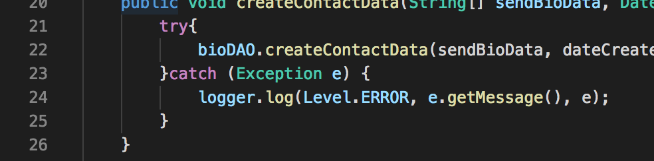
Logging - Java

Slide 118
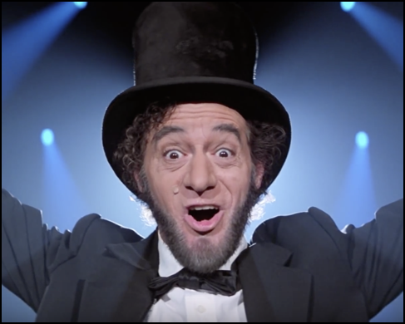
Auditing
Exercise Abraham Lincoln
Continue review of ~/code/skea_django
Build/Review Auditing Checklist
Continue review of ~/code/keystone
Build/Review Auditing Checklist
Notes:
Are logs enabled in skea_django? Where do they go? What’s in them? What about keystone?

Slide 119
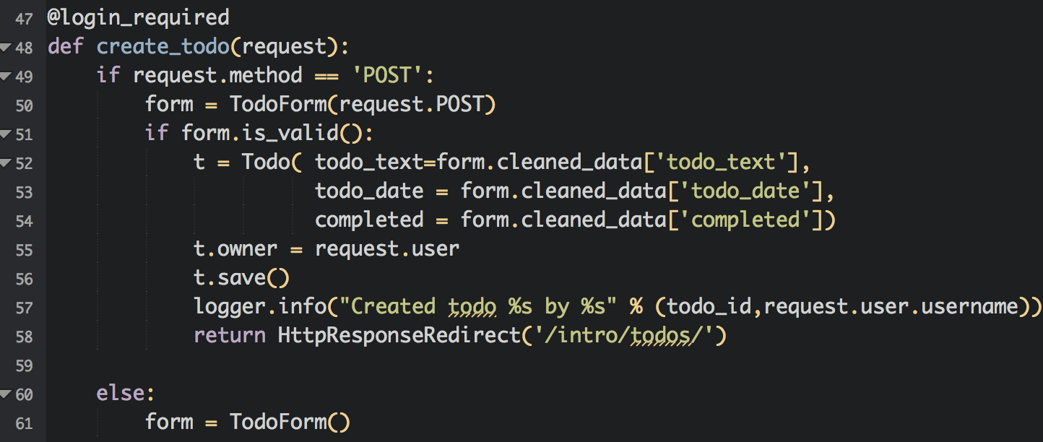
Abraham Lincoln Exercise - Post-Mortem
So where should we look? Sensitive functions.

Slide 120

Abraham Lincoln Exercise - Post-Mortem
It’s django, so everything is setup in settings.py.
The intro application goes right along with this.

Slide 121
Injection

Slide 122
Injection
Causes:
Input Validation
Output Encoding
Types
SQL Injection
HTML Injection (XSS)
LDAP, XML, Command ...

Slide 123
Injection Vulnerabilities
Injection - OWASP Top 10 A1:2017
XML External Entities (XXE) - OWASP Top 10 A4:2017
Cross-Site Scripting (XSS) - OWASP Top 10 A7:2017
Redirects
SSRF

Slide 124
Input Validation
Analyze code that handles user input for type, format, and content validation before being used or stored by the application.
Compile list of data sources to work through.
Start with the routes identified in the information gathering phase, but also include:
Configuration files
Environment variables
External services
Database calls to external and internal databases.
...

Slide 125
Input Validation - Checklist
Is all input is validated without exception?
Do the validation routines check for known good characters and cast to the proper data type (integer, date, etc.)?
Is the user data validated on the client or server or both (security should not rely solely on client-side validations that may be bypassed)?
If both client-side and server-side data validation is taking place, are these validations consistent and synchronized?
Do string input validation use regular expressions?
Do these regular expressions use blacklists or whitelists?
What bypasses exist within the regular expressions?

Slide 126
Input Validation - Checklist
Does the application validate numeric input by type and reject unexpected input?
How does the application evaluate and process input length?
Is a strong separation enforced between data and commands (filtering out injection attacks)?
Is there separation between data and client-side scripts?
Is provided data checked for special characters before being passed to SQL, LDAP, XML, OS and third party services?
For web applications, are often forgotten HTTP request components, including HTTP headers (e.g. referrer) validated?

Slide 127

SQL Injection - Django

Slide 128

SQL Injection - Node.js

Slide 129
Output Encoding
Analyze code that sends user data to client for context, type, and format before sending to uncontrolled data sinks.
Start with a list of data sinks where data is being stored, sent, processed.
Source code libraries
3rd-party services
Storage components (database in any of its possible forms)
File system interactions
Log files
XSS, SSRF

Slide 130
Output Encoding - Checklist
Do databases interactions use parameterized queries?
Do input validation functions properly encode or sanitize data for the output context?
How do framework-provided database ORM functions used?
Does the source code use potentially-dangerous ORM functions? (.raw, etc)
What output encoding libraries are used?
Are output encoding libraries up-to-date and patched?
Is proper output encoding used for the context of each output location?
Are output encoding routines dependent on regular expressions? Are there any weaknesses or blind-spots in these expressions?

Slide 131

XSS - Node.js (ejs templates)

Slide 132

XSS - Django

Slide 133

Injection
Exercise Billy the Kid
~/code/skea_django
Build Injection Checklist
Trace all sources To sinks
~/code/keystone
Build Injection Checklist
Trace at least 3 different sources to sinks

Slide 134

Exercise Billy the Kid - Post-Mortem
Some sources have already been identified. Are there others?
Configuration files, additional services, even databases.
Settings.py is somewhat trusted, but other people could manipulate data in the database before it gets to us.

Slide 135

Exercise Billy the Kid - Post-Mortem
Now for sinks, we know that the database file is one, but what else?
Anywhere data is /sent/ somewhere, file system, user, etc.

Slide 136

Exercise Billy the Kid - Post-Mortem
Search for user.username shows multiple references.

Slide 137

Exercise Billy the Kid - Post-Mortem
Diagram for user.username ends up looking like this.

Slide 138
Exercise Billy the Kid - Post-Mortem
This means we will be looking for the following injection flaws:
SQL Injection (database storage)
XSS (Stored/Reflected)
Log Forging/Injection

Slide 139
Cryptographic Analysis

Slide 140
Cryptographic Analysis
Analyze code for encryption flaws, outdated protocols, custom-developed algorithms, weak encryption, and misuse
Automated tools will uncover some of this, including
Use of older hashing algorithms (MD5, SHA-1, etc)
Code and routes that handles sensitive information specifically should be reviewed
API Tokens
Credit Card Numbers
Social Security Numbers
Customer Data
IDE Search for the following terms:
md5, sha1, base64, encrypt, decrypt, secure

Slide 141
Cryptographic Analysis Vulnerabilities
Lack of Encryption
Improper Encryption
Insecure Token Generation/Randomness

Slide 142
Cryptographic Analysis - Checklist
What are the standard encryption libraries are used for?
Hashing functions - password hashing, cryptographic signing, etc
Encryption functions - data storage, communications
Do the strength of implemented ciphers meet industry standards?
Less than 256-bit encryption
MD5/SHA1 for password hashing
Any RC4 stream ciphers
Certificates with less than 1024-bit length keys
All SSL protocol versions
Are cryptographic private keys, passwords, and secrets properly protected?

Slide 143

Cryptographic Analysis
Exercise Beeth-oven
~/code/skea_django
Build Crypto Checklist
How are passwords stored/tokens generated
~/code/keystore
Build Injection Checklist
What hashing/crypto is being used?

Slide 144

Exercise Beethoven - Post-Mortem
Sessions - Only indication we have of activity is settings.py

Slide 145

Exercise Beethoven - Post-Mortem
Sessions - Django documentation helps us out a little.

Slide 146

Exercise Beethoven - Post-Mortem
Sessions - but also gives us a warning...

Slide 147

Exercise Beethoven - Post-Mortem
Alright, so we should check the randomness of the SECRET_KEY
Looks random and secure, right? What are the concerns you have with this? Bueller?

Slide 148
Exercise Beethoven - Post-Mortem
Possible issues (outside of encryption routines):
Hardcoded values stored in source
Same key used for dev/staging/production

Slide 149

Exercise Beethoven - Post-Mortem
Password Storage? Nothing in settings.py?

Slide 150

Exercise Beethoven - Post-Mortem
PASSWORD_HASHERS in settings.py

Slide 151

Exercise Beethoven - Post-Mortem
Did you run the app?

Slide 152
Configuration Review

Slide 153
Configuration Review
Analyze any configurations included for security flaws
Includes language, framework, and server configurations
Highly specific to the targeted language/framework
Consult the server/framework documentation for guides on security flags and settings.
Examples:
Administrative Functionality enabled through configuration files
CSRF settings
Cookie parameters

Slide 154
Configuration Review Vulnerabilities
Security Misconfiguration - OWASP Top 10 A6:2017
Insecure defaults
Incomplete configurations
Open cloud storage
Using Components with Known Vulnerabilities - OWASP Top 10 A9:2017
Any dependencies, libraries, services

Slide 155
Configuration Review - Checklist
Are any endpoints enabled through configurations properly protected with authentication and authorization?
Are security protections implemented in framework properly configured?
Does the target language and framework version have any known security issues?
Are configuration-controlled security headers implemented according to recommended best practices?

Slide 156

Configuration Analysis
Exercise Joan of Arc
~/code/skea_node and keystore
Build Config Checklist
Run/review npm audit and nodejsscan
~/code/skea_rails and railsgoat
Build Config Checklist
Run/review brakeman

Slide 157

Security Misconfiguration - Java Spring

Slide 158
Additional Resources

Slide 159
Additional Resources
OWASP Code Review Guide - Includes some language-specific best practices for Java, .Net, C, C++.
Simplicable Secure Code Review Checklist
Infosec Institute - Secure Code Review: A Practical Approach
OWASP Input Validation Cheatsheet
OWASP XSS Prevention Cheatsheet
Recommended headers for internal and external Web User Interfaces
Wikipedia - Principle of Layered Security
Wikipedia - Principle of Least Privilege
OWASP ASVS (Application Security Verification Standard)

Slide 160
Reporting and Retesting

Slide 161
Reporting and Retesting
This phase of the methodology is critical.
Document findings in a manner that can be understood by a developer.
Review the source after remediation using the same techniques (rinse & repeat).
THIS IS THE WHOLE POINT.

Slide 162
Report Writing (or ticket creation)
Detailed findings include:
Description
Applicable File, Function, Variables, Line Numbers
Risk Severity
Likelihood of Exploitation
Ease of Exploitation
Remediation Approach
References

Slide 163
Walkthrough:
Vulnerable Task Manager

Slide 164
Open Source Projects

Slide 165


Slide 166
Ken - cktricky@gmail.com
Seth - seth@redpointsecurity.com

